Slide 1
Introduction to R, RStudio, and R Markdown
Joseph Rudolf
R/Medicine 2020

Slide 2



R
Programming language for
data analysis
R Markdown
Computational document format
(uses R for executable code)
RStudio
Editor for writing
R Markdown
Notes:
Before I show you what a computational document looks like and how it fits into a reproducible workflow, let me introduce a few additional terms.
The first is R. R is a programming language for data analysis. We use R for a lot of reasons, including that it’s free, it’s great for wrangling data, and it creates great graphics. Also, you can use R to pull data from any of the databases that are being used at Penn and CHOP, such as Epic, Cerner, and SOFT. doing basic data analysis with R is actually not that difficult to learn for non-programmers.
(**) Then there’s R Markdown. R Markdown is a computational document format that has executable code usually written in R. I say usually because it’s actually possible to write code in python, C++, and a other languages inside of an R Markdown document.
(**) Finally, there’s RStudio. RStudio is the name of a company and also the name of a piece of software this company makes and makes available for free. You can think of RStudio as a fancy editor for writing R and R Markdown. You can run RStudio on Mac or Windows, or, if you’re concerned about protecting patient data or intellectual property, it’s straightforward to lock down an RStudio server behind the hospital firewall.

Slide 3
RStudio

Slide 4

RStudio: In the Cloud… In Your Home
RStudio Cloud: An online hosted version of RStudio that we will use for these course sessions
RStudio Desktop: A locally installed version of RStudio that you will use when you get home to continue your learning
Note: Use Rstudio Cloud only for this course. Do not upload protected health information to the cloud!

Slide 5
RStudio on your computer or on the web
RStudio Server
Hosted on a server
(in the cloud)
RStudio Desktop
Installed locally on your computer
Notes:
RStudio Server – a version of the RStudio IDE that can be accessed from a web browser. This is what we’re using as a training environment today.
RStudio Desktop – a version of the RStudio IDE that is installed on your computer. This is what you should use after the course to continue learning R and working on R projects.

Slide 6
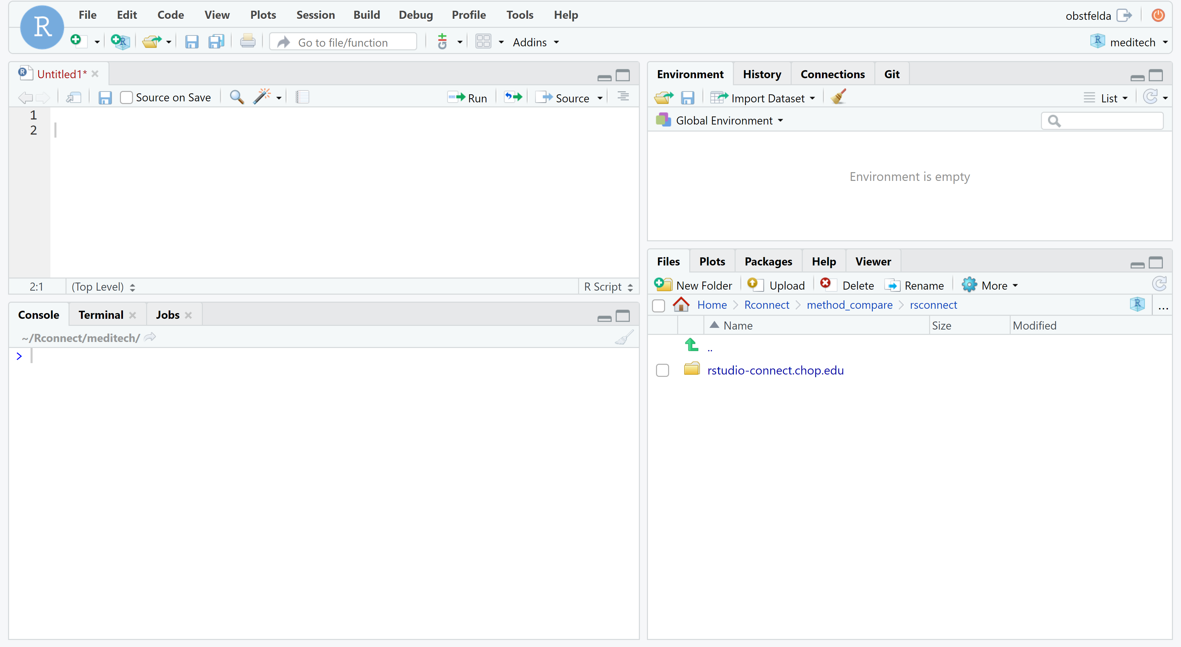
ENVIRONMENT
EDITOR
CONSOLE
MISC
Notes:
Here’s what the RStudio window looks like.
On the top left is the editor. This is where you enter code.
On the top right is the Environment. The environment allows you to look at the data that’s loaded into R. This gives you back some of the functionality of working in Excel.
The Console on the bottom left. You can use the console quickly run an individual R command, like install a package. We won’t use the console too much in this course.
The lab I’ve labeled “MISC” has a couple of tabs. The most important one for today is the “Files” tab which shows the files we’ll be using for the course.

Slide 7
Your Turn #1
Go to rmed2020.cloud in your browser and log in using the username and password provided in the email.
Click “yes” once you see the RStudio panes.

Slide 8
R Markdown
Notes:
(Might wan to mention here – next few min will be background and not critical to understand the rest, so if there are issues with logging into the server, please have TAs help troubleshooting now.)

Slide 9
18
The Duke Cancer Scandal
Chemo sensitivity from microarrays
Errors first, then cover-up
Clinical trials based on flawed models
Papers retracted, lawsuits settled
Notes:
In the mid-2000s, Anil Potti and Joseph Nevins of Duke University tried to use microarray gene expression data of tumor cells to predict sensitivity to chemotherapeutic agents. This approach generated a lot of excitement at the time, and their papers got published in high-profile journals including Nature Medicine, JAMA, and the New England Journal.
(**) Unfortunately, there were a number of serious errors in the data analysis. The media has focused on the fact that the researchers tried to cover up investigations into these errors and press on towards clinical trials even though there were at the time open questions about the validity of their method.
(**) Even more unfortunately, patients were enrolled in clinical trials and allocated based on flawed models, and in all likelihood patients were actually allocated to the incorrect treatment arm.
(**) In the end, 18 papers were retracted, and Duke settled 11 or more lawsuits for an undisclosed amount of money.

Slide 10
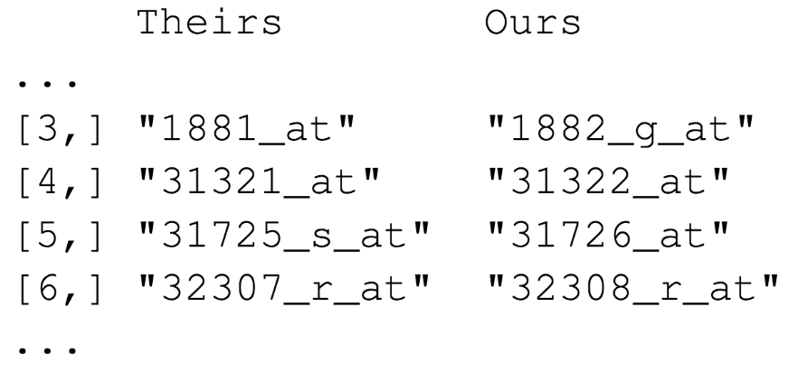

Duke
MD Anderson
Off-by-one indexing error
Notes:
Keith Baggerly and Kevin Coombes, biostatisticians at MD Anderson uncovered the mistakes that led to these retractions, in painstaking work. Let’s look at one of the errors they found.
These are a few of the hundreds of microarray probe sets – each corresponds to a gene – that the Duke investigators reported to predict sensitivity to 5-fluorouracil.
(**) And here are the probe sets that the MD Anderson team got. You can see that those two are different.
(**) If I highlight the last number of each probe, you might appreciate a pattern: the number of the probe set that Duke reported is exactly one less than the number of the probe that MD Anderson found when they re-did the analysis.
(**) This is what’s called a off-by-one indexing error and is what happens when you use Excel and accidentally delete one cell, and as a result all the values in the affected column are shifted by one. This is a simple error to make, but as you might imagine, this error completely invalidates all downstream results.

Slide 11
“Common problems are simple…
Off-by-one indexing error
Sensitive / resistant label reversal
Confounding in experimental design
Inclusion of data from non-reported sources
Wrong figure shown
… and simple problems are common.”
Notes:
The off-by-one indexing error was just one of many simple errors the MD Anderson team discovered.
(**) Another type of error that was pervasive in the study was label reversal so that cell lines were labeled sensitive to a drug when they actually were resistant, and vice versa. That type of error can lead to a scenario where a patient gets the chemotherapy that would be predicted to be least beneficial.
(**) Other problems they identified were confounding, (**) inclusion of data from sources that were not reported in the paper, (**) and wrong figure shown.
These are all pretty simple errors – you don’t have to be egregiously incompetent or negligent to make them. (**) And because they’re so easy to make, and without good documentation or a reproducible workflow it’s hard to catch them, they are also very common.

Slide 12
Point-and-click is not reproducible
Computer code can precisely document each step of the analysis
Notes:
So a key issue in this case study is that the investigators used point and click tools like Excel.
This prevented peers and independent investigators from catching errors in the analysis, until it was too late.
And the Duke case study is only one example where the critical barrier to reproducibility was the tendency of investigators to use graphical user interface “point-and-click” type tools. These interactive tools usually don’t record user actions and because of this, they are fundamentally not reproducible.

Slide 13
Why YOU should analyze your data reproducibly
“Can we redo the analysis with this month’s data?”
“Why do the data in Table 1 not seem to agree with Figure 2?”
“Why did I decide to omit these six samples?”
Your closest collaborator is You from 6 months ago
(But you don’t answer e-mails)
Notes:
But reproducibility doesn’t only help others, which makes sense when you consider the following three statements and ask yourself if they sound familiar.
…
* …
(On a more serious note - if you’re analyzing clinical data and might affect patient management or public health based on your findings, that makes it so much more important that you take steps to assure your analysis is free of errors.)

Slide 14
Notes:
R Markdown allows you to have computer code mixed in with English narrative that documents the purpose of the code and details about decisions that you made in the analysis.

Slide 15
Anatomy of an R Markdown Document
Header
---
output: html_document
---
Header
Text (with marks)
Code chunk

Slide 16
Notes:
An R Markdown document is a regular text file that has “marks” to add styling. This text document can then be converted into a HTML or PDF document, in a process called “knitting”.
The “marks” (#, *, brackets for link) are designed to be easy to read and remember.
**
Rmarkdown lets you add chunks of R code. This code - don't worry about how it works at this point - generates 100 normally distributed random numbers and assigns them to a variable called x. It then runs the summary function on x.
As you can see, in the rendered document the code chunk is placed neatly in a gray box to make it visually distinct from the marked up narrative text.
**
But here’s where it gets exciting: the rendered document also runs the code and shows the result right below the code! This way, a neatly formatted report is automatically the by-product of a completed analysis.
**
You can also include plots. Here we’re running the hist function on x, and the rendered document shows a histogram of the values in x.

Slide 17
R Code

Slide 18
The Data Analysis Pipeline
From R for Data Science (https://r4ds.had.co.nz/introduction.html)
Notes:
Motivation:
* import a file that contains COVID19 test results from the microbiology lab. The data is stored in a CSV file.

Slide 19

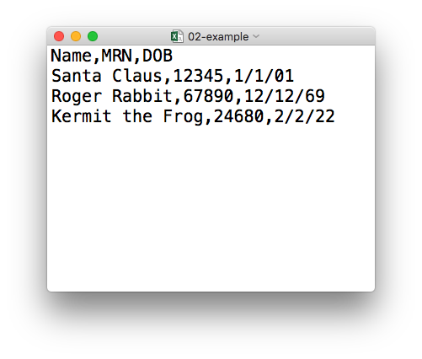
plain text (“flat”) file
csv
rectangular structure
header row
Notes:
So what’s a CSV file? CSV stands for comma-separated values.
* A CSV file is a plain text file, which means you can open it in a text editor and look at it.
Here we have a CSV file with the names, MRNs, and date of birth of three “patients”
* This data structure is called rectangular because it falls into rows and columns, where each row has the same # of columns, and each columns has the same # of rows.
* Also note that this particular CSV file has a header row that, instead of data, has a descriptor of what kinds of data are found in each column. CSV files often but not always have such a header row.

Slide 20
Tidyverse: R Packages for Data Science
A consistent way to organize data
Human readable, concise, consistent code
Build pipelines from atomic data analysis steps
Notes:
The Tidyverse is a modern set of tools for data analysis in R. It’s quickly becoming the de facto standard for doing data science with R.
The basic tenets of “tidy” data analysis include:
Data should be organized in a consistent, standardized way. Each row is an observation, and each column is a variable. This is a very common way to organize data in a spreadsheet and might sound familiar from how you already organize your data in Excel.
Programming code that acts on the data should be consistent, concise, and mimic the English language as much as possible.
Each data analysis can be broken down into a series of atomic steps, such as “select this column” or ”arrange the data by the values in that column”. An arbitrarily complex data analysis can be broken down as a pipeline of atomic steps.

Slide 21
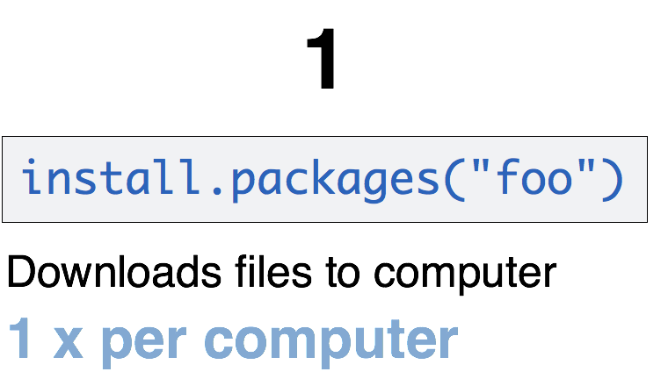
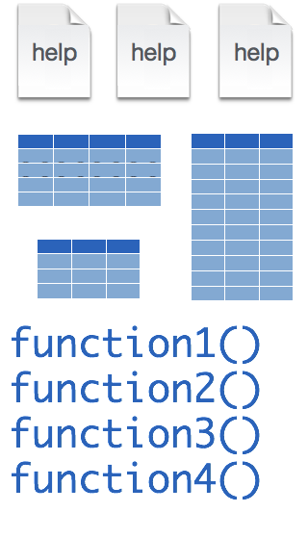
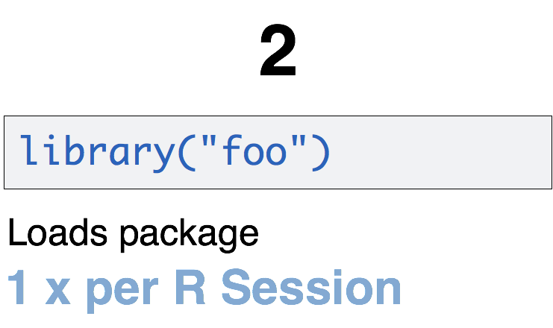
Installing and loading R packages
tidyverse
install.packages("tidyverse")
library("tidyverse")
Notes:
One of the features that makes R powerful is the fact that it’s easy to extend its functionality with packages.
A package is a essentially a zip file that contains data sets, functions, and help files that document those data sets and functions.
Packages need to be installed explicitly – with the command install.packages. So let’s say you want to install a package named “tidyverse”. You go to the R Console and type install.packages(“tidyverse”).
Each package you want to use needs to be installed only once on each computer. However, in order to use the functions or data in the package, you also need to load the package. This is done with the command “library”. So to enable all the functions in the “tidyverse” package, you type library(“tidyverse”). Packages remain loaded until you quit R. So every time you start a new R session you have to load each package that you want to use again.
On our RStudio Server, you won’t need to install any packages for this course. But at times you’ll need to load packages. We’ll practice this later.
So these are the first two R commands we’ve covered - install.packages and library.

Slide 22

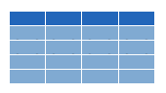

read_csv()
data_frame <- read_csv(file_name)
csv
Notes:
You can import CSV files using the read_csv() function. Here is a template for how to use the read_csv function to create a data frame object from a CSV file. You start with the name of a data frame object then you have this left-ward arrow then read_csv and then the file name in parentheses.

Slide 23
function
(does stuff)
data_frame <- read_csv(file_name)
Notes:
This code construct is exceedingly common in R, so I want to spend a few minutes exploring it.
read_csv() is a function. Remember that functions are defined in packages. We loaded the readr package (which is part of the tidyverse set of packages) to be able to use the read_csv function.
You all remember functions from calculus. It’s something that takes an input, say an ‘x’ value and returns an output, say a ’y’ value. Functions in computer programming also take input and return outputs. But the inputs and outputs here are objects that exist within the context of a programming language. For read_csv, the input is a the file name of a CSV file; and the output is a data frame with the contents of the file.

Slide 24
function
(does stuff)
argument
(input)
data_frame <- read_csv(file_name)
Notes:
The input that goes into a function is called an argument. The argument to a function gets put in parentheses.
A function can have zero, one, or many arguments. If there is more than one argument, you’d use commas to separate them. We’ll see examples of that later.

Slide 25
object
(stores output)
function
(does stuff)
argument
(input)
data_frame <- read_csv(file_name)
Notes:
- So again, read_csv outputs a data frame, but we want to *capture* that data frame inside of a named object. The reason is that we want to hand that object to other functions so they can do other stuff with it, for example, summarize or visualize the data in it.

Slide 26
object
(stores output)
function
(does stuff)
argument
(input)
data_frame <- read_csv(file_name)
assignment operator
(“gets”)
Notes:
To put the output of the read_csv function into a named object, you use the assignment operator.
The assignment operator is a smaller-than followed by a dash or minus and looks kind of like an arrow pointing left. It’s usually read as “gets.”

Slide 27
read_csv()
data frame to read data into
name of
CSV file
covid_testing <- read_csv("covid_testing.csv")
covid_testing
covid_testing.csv
csv
Notes:
So, for example in this line of code the object test_df gets a data frame created by read_csv as it reads a file named test_data.csv.
The line reads “test_df gets read_csv of test_data.csv.”
You might notice that one of the objects is put in quotes and the other one isn't.
To be honest, quotes can be confusing. Names of objects such as data frames don't get quotes. In contrast, literal file names are always put in quotes.

Slide 28
Your Turn #2
(Run a code chunk and view the contents of the data frame. Answer some questions about it, e.g. how many rows, how many positives. This exercise should perhaps be inside an R Markdown document.)

Slide 29
Recap
RStudio is..
R Markdown …
R …
Notes:
To recap what we covered up to this point, …
(**) Analyzing data with with Excel, or similar spreadsheet software, can compromise data quality, and may ultimately lead to patient harm. This is because Excel does not record user interactions and it’s easy to make simple errors that can be very difficult to uncover later.
(**) Instead, you could use a reproducible workflow in which the entire analysis is automated with computer code, and we looked at how doing that can improve your confidence in the validity of an analysis.
(**) and finally, we defined “computational document” as documents that have executable code inside of them and we went over how computational documents are a key ingredient of reproducible workflows.

Slide 30
What else?

Slide 31
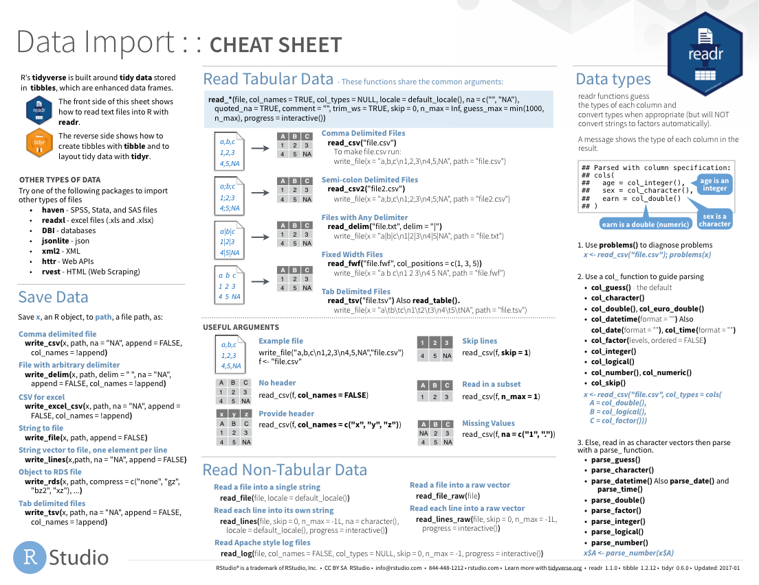
Notes:
The Data Import cheat sheet actually answers the question how to import pipe-delimited files.

Slide 32
Notes:
Readxl: Excel
Haven: SPSS, Stat, SAS files
Googlesheets
Rvest: scrape the web
Jsonlite: JSON data and APIs on the web

Slide 33
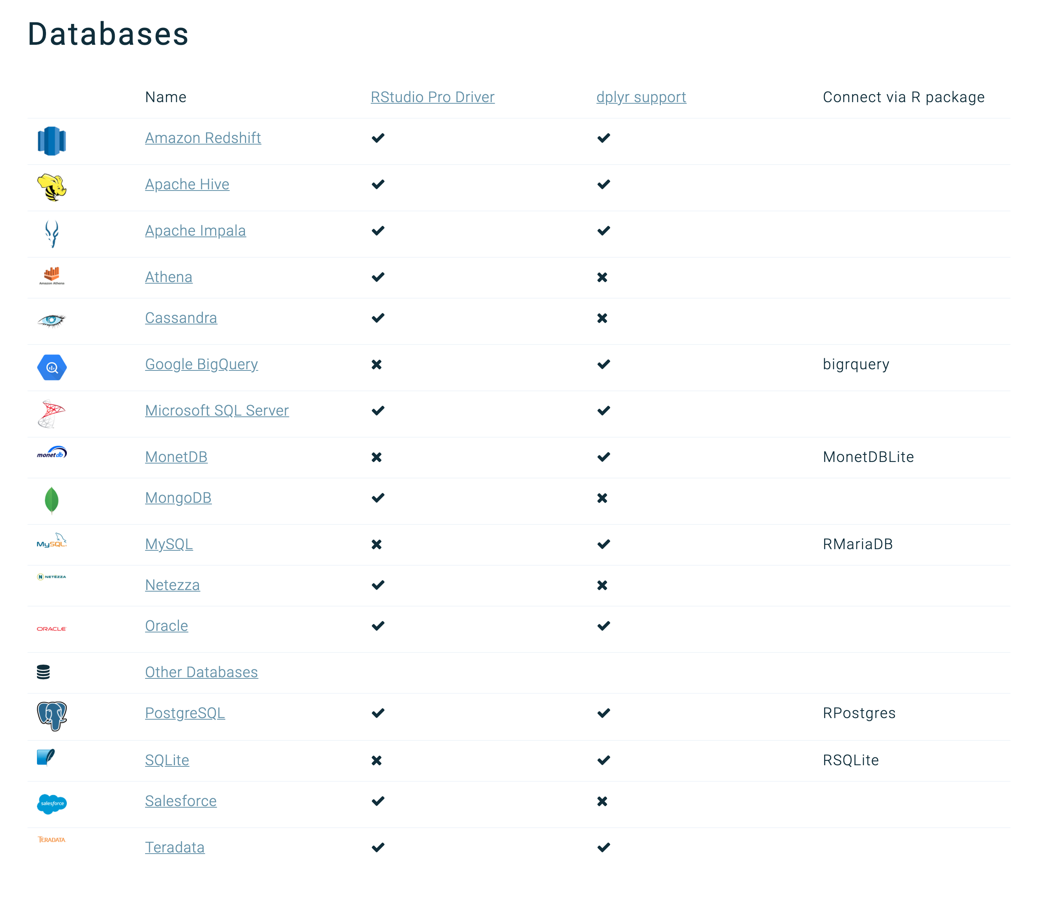
Databases
https://db.rstudio.com/databases/

Slide 34





Notes:
You can “knit” or convert R Markdown documents into a bunch of different formats, such as (**) HTML, (**) PDF, but also (**) Microsoft Word, and (**) PowerPoint. And even (**) interactive dashboards.

Slide 35
R Interface to Python
```{python}
import pandas
covid_testing.info()
```
Notes:
The reticulate package provides an interface between R and python. This means, you can mix code chunks written in R with code chunks written in python.

